Slide 1

Sequence Diagrams

Slide 2
Sequence Diagrams
In a sequence diagram, you can describe which interactions will be triggered when a particular use case is executed and in what order those interactions will occur.
In short, the sequence diagram communicates the order of events within an interaction.

Slide 3
Sequence Diagrams
A sequence diagram is made up of
  An actor
  a collection of participants.
  The parts of your system that interact with each other

Slide 4
Sequence Diagrams
Regardless of where a participant is placed vertically, participants are always arranged horizontally with no two participants overlapping each other.
Each participant has a corresponding lifeline running down the page.
A participant's lifeline simply states that the part exists at that point in the sequence.

Slide 5

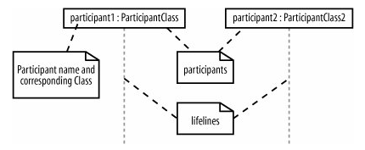
Example

Slide 6
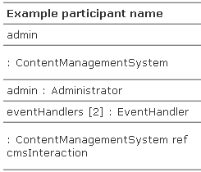
Participant Names
Participants on a sequence diagram can be named in number of different ways, picking elements from the standard format:
name [selector] : class_name ref decomposition

Slide 7
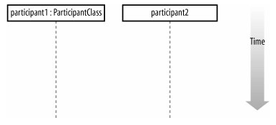
Time
A sequence diagram describes the order in which the interactions take place, so time is an important factor.
Time runs down the page on a sequence diagram in keeping with the participant lifeline.

Slide 8
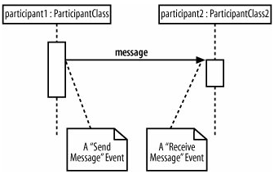
Events, Signals, and Messages
The smallest part of an interaction is an event.
An event is any point in an interaction where something occurs

Slide 9
Events, Signals, and Messages
Events are the building blocks for signals and messages.
Signals and messages are really different names for the same concept: a signal is the terminology often used by system designers, while software designers often prefer messages.
An interaction in a sequence diagram occurs when one participant decides to send a message to another participant.

Slide 10
Events, Signals, and Messages
Events are the building blocks for signals and messages.
Signals and messages are really different names for the same concept: a signal is the terminology often used by system designers, while software designers often prefer messages.
An interaction in a sequence diagram occurs when one participant decides to send a message to another participant.

Slide 11
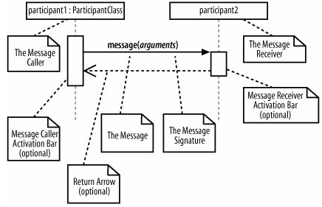
Events, Signals, and Messages

Slide 12
Events, Signals, and Messages
Messages on a sequence diagram are specified using an arrow from the participant that wants to pass the message, the Message Caller, to the participant that is to receive the message, the Message Receiver.
Messages can flow in whatever direction makes sense for the required interaction; from left to right, right to left, or even back to the Message Caller itself.

Slide 13
Message Signatures
A message arrow comes with a description, or signature. The format for a message signature is:
attribute = signal_or_message_name (arguments) : return_type
You can specify any number of different arguments on a message, each separated using a comma. The format of an argument is:
<name>:<class>

Slide 14
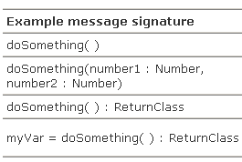
Message Signatures

Slide 15
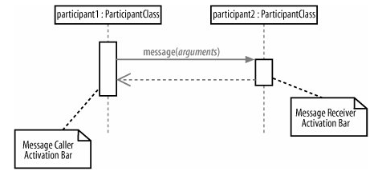
Activation Bars
When a message is passed to a participant it triggers, or invokes, the receiving participant into doing something; at this point, the receiving participant is said to be active. To show that a participant is active, i.e., doing something, you can use an activation bar

Slide 16
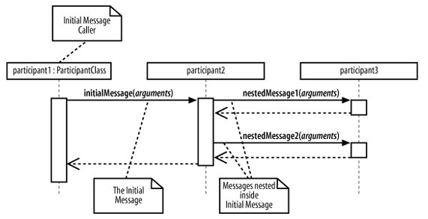
Nested Messages
When a message from one participant results in one or more messages being sent by the receiving participant, those resulting messages are said to be nested within the triggering message.

Slide 17
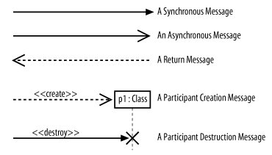
Message Arrows
There are five main types of message arrow for use on sequence diagram, and each has its own meaning

Slide 18
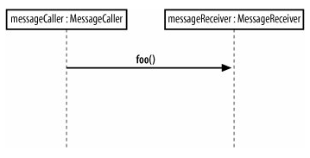
Synchronous Message
A synchronous message is invoked when the Message Caller waits for the Message Receiver to return from the message invocation

Slide 19
Asynchronous Message
An asynchronous message is invoked by a Message Caller on a Message Receiver, but the Message Caller does not wait for the message invocation to return before carrying on with the rest of the interaction's steps.
This means that the Message Caller will invoke a message on the Message Receiver and the Message Caller will be busy invoking further messages before the original message returns

Slide 20
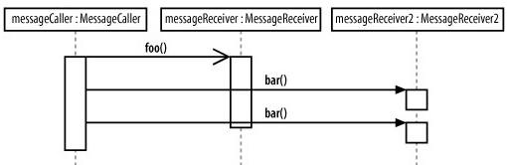
Asynchronous Message

Slide 21
Return Message
The return message is an optional piece of notation that you can use at the end of an activation bar to show that the control flow of the activation returns to the participant that passed the original message.
You don't have to use return messages sometimes they can really make your sequence diagram too busy and confusing.

Slide 22
Participant Creation and Destruction Messages
Participants do not necessarily live for the entire duration of a sequence diagram's interaction. Participants can be created and destroyed according to the messages that are being passed.

Slide 23
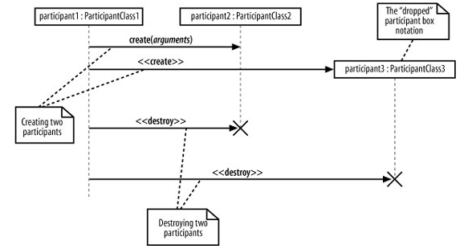
Participant Creation and Destruction Messages

Slide 24
Example
We are now going to see an example live

Slide 25
The End

